Slide 1
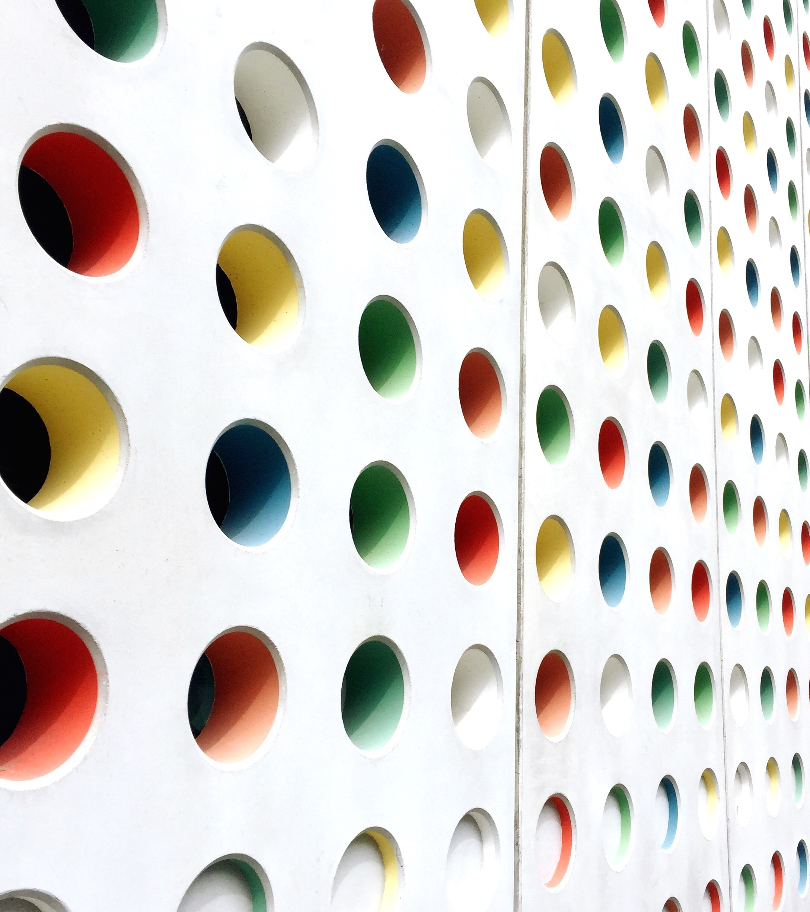
Match Making WebApp
Siddhant Fulzele
Tejas Akadkar
Trupti Kachare

Slide 2
Problem Statement
Dating apps have been beneficial for many people who have fallen in love through those apps. But many people have bad experience regarding the matches on the app etc. So, using machine learning we can enhance the dating app experience.
Match
Chat
Date

Slide 3


Solution
One of the solution to this is – showing random user profiles as recommendations.
Else, better and our approach is to show recommendations based on Machine Learning.
Random Recommendations
AI Based Recommendations

Slide 4
Data Description
For this project ,data of OkCupid (An online dating app) has been used.
Data contains records of 2001 users of this dating app.
The dataset consists of parameters such as age, sex, orientation, their interests and preferences, and so on.

Slide 5
Data Description
Data Contains Following Columns
User ID 17. Bio
Username 18. Interest
Age 19. Location Preference
Sex
Orientation
Status
Drinks
Drugs
Height
Job
Location
Pets
Smokes
Body Profile
Education Level
Dropped Out

Slide 6
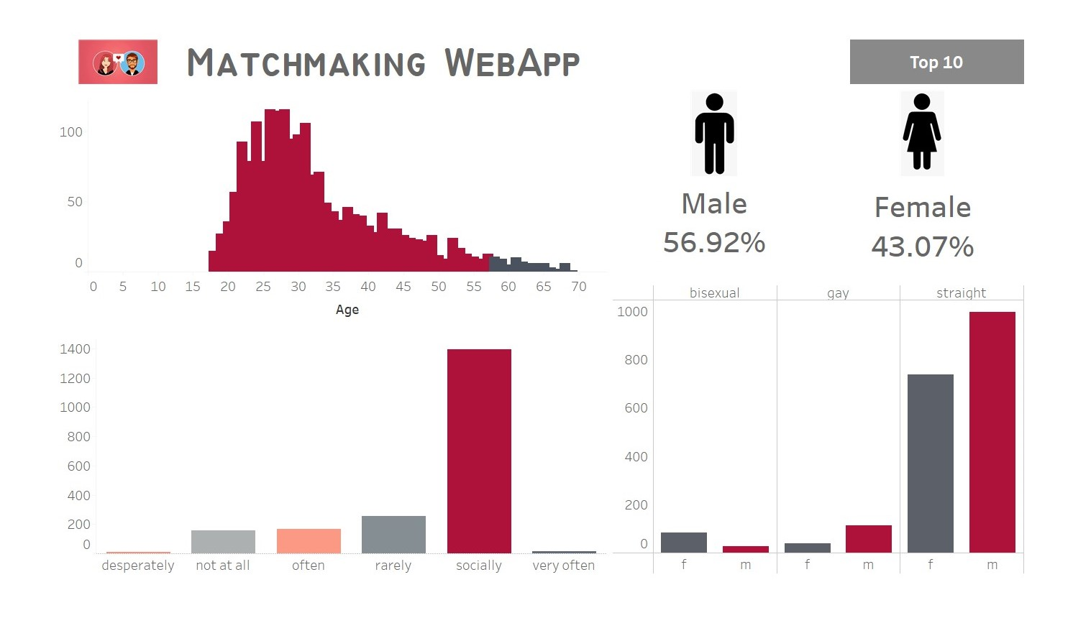
Dashboard

Slide 7
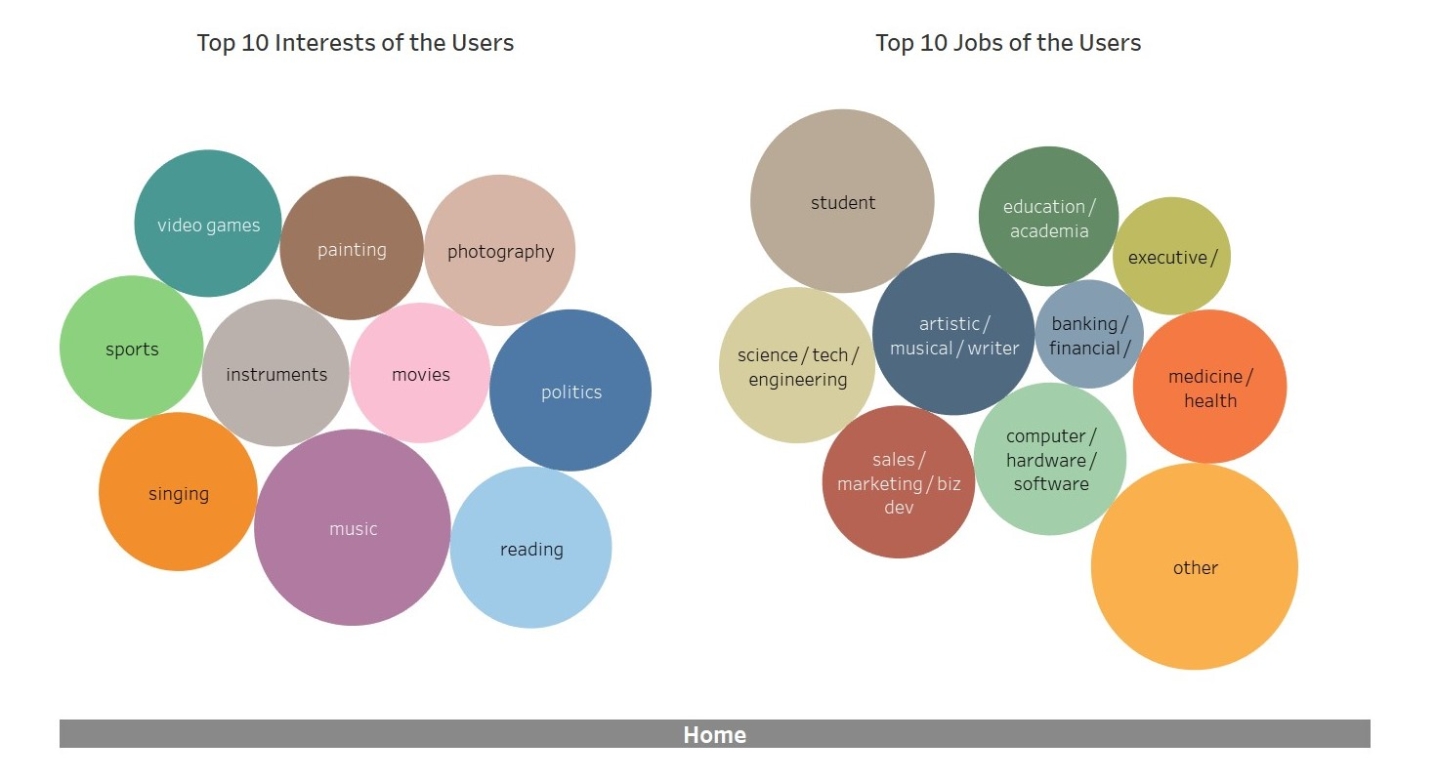
Dashboard

Slide 8
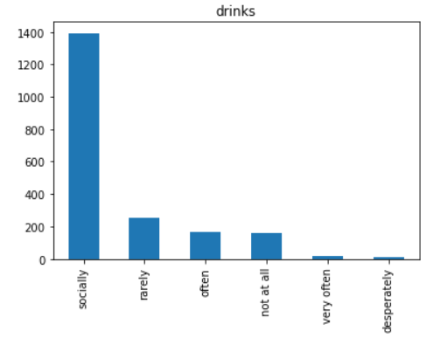
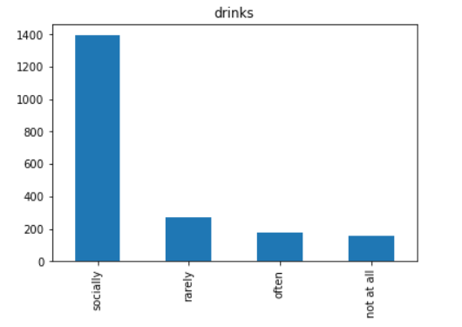
Data Pre Processing
Before
After

Slide 9
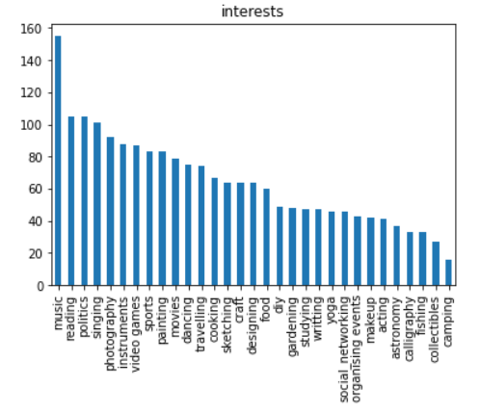
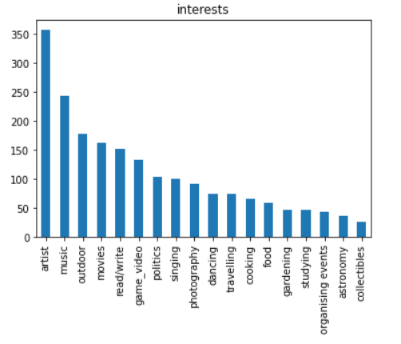
Data Pre Processing
Before
After

Slide 10
Data Pre Processing - NLP
Remove Punctuations
Convert to lowercase
Remove Numbers
Remove Emojis
Remove Stop words
Remove whitespaces
Lemmatization

Slide 11
Data Pre Processing - NLP
Data Cleaning
All the functions mentioned earlier
Topic Modelling
Using Count vectorizer and TF-IDF
Latent Semantic Analysis (LSA)
LSA to reduce dimensionality
Clustering
Vectorize and Cluster using Word2vec
Similar to SVD
Nonnegative matrix Factorization
Reduce dimensionality

Slide 12
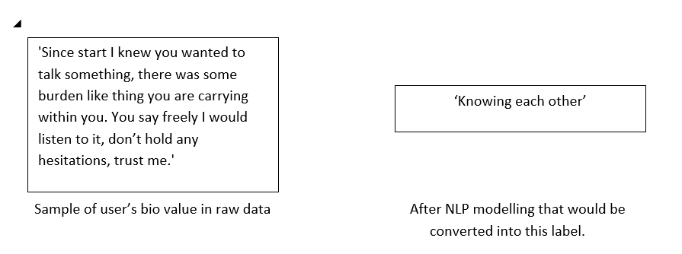
Data Pre Processing

Slide 13
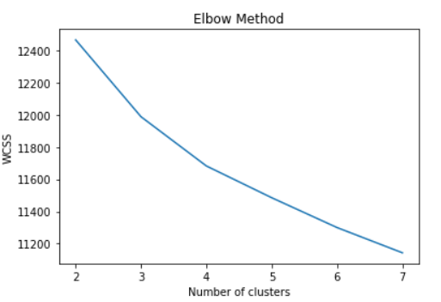
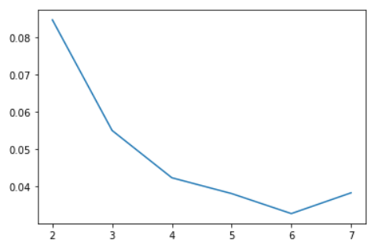
Model Building (Clustering)
WCSS
Silhouette Score

Slide 14
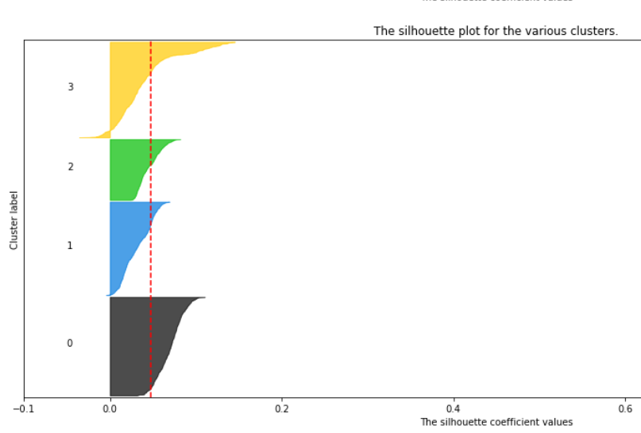
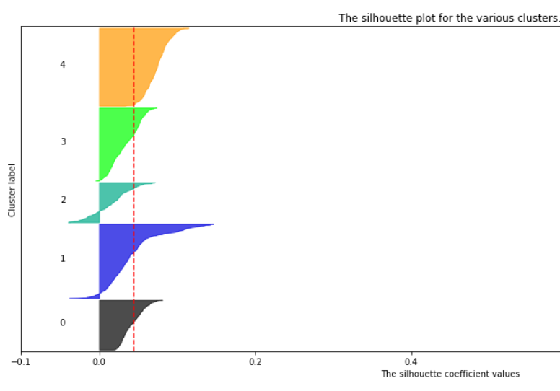
Model Building (Clustering)
Silhouette Score
Silhouette Score

Slide 15
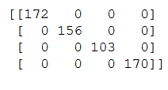
Model Building (Classification)
confusion matrix of logistic model’s output on test split

Slide 16
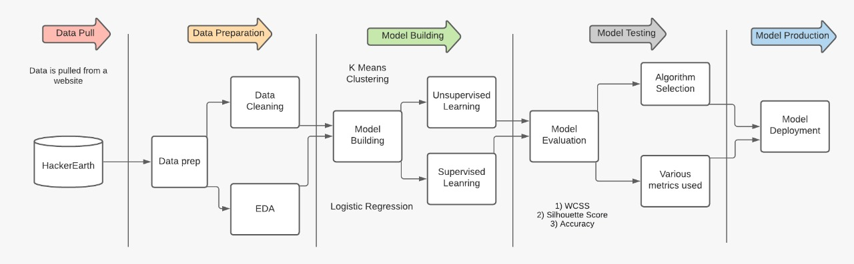
Data Flow

Slide 17
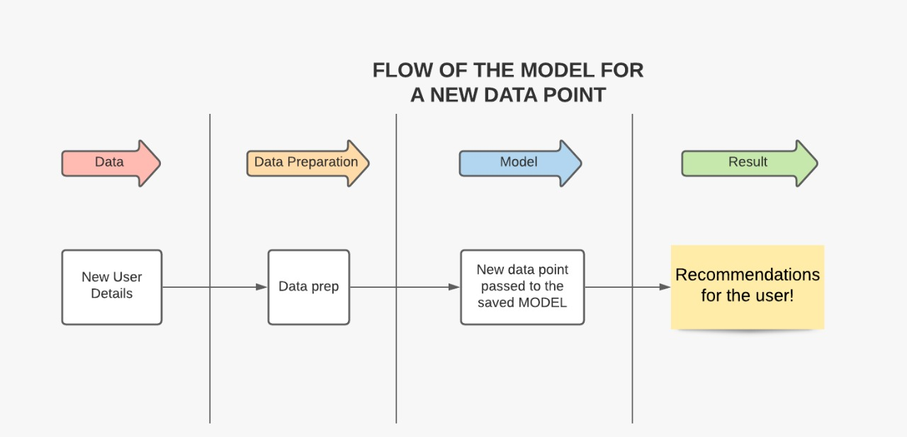
Data Flow

Slide 18
Live Demo
Live Demo of Deployed ML model and UI created Using Flask Framework

Slide 19
Thank You..!!

